Slide 1
SF IHSS Public Authority
January 10, 2020
The mission of San Francisco’s In-Home Supportive Services (IHSS) Public Authority is to provide and promote a service delivery model of consumer directed, in-home support that maximizes the potential of older adults and people with disabilities to live independently and participate in their communities.

Slide 2
Agenda
Annual Fiscal Compliance Audit
Programs
  Registry
    For Consumers
    For Providers
  Emergency On-Call
  Mentorship
  Provider Benefits

Slide 3
Annual Fiscal Compliance Audit
For Fiscal Year 2018-2019, DAAS granted SF IHSS Public Authority a “Good Performance Waiver” from citywide fiscal and compliance monitoring.
  Each year, the Public Authority has 1 external audit and 1 DAAS fiscal and compliance audit. For every year since January 2010, since onboarding the current Director of Finance and Operations, the audits had no findings.
  For the first time last year, DAAS waived their annual fiscal compliance audit since the Public Authority had never had any findings.

Slide 4
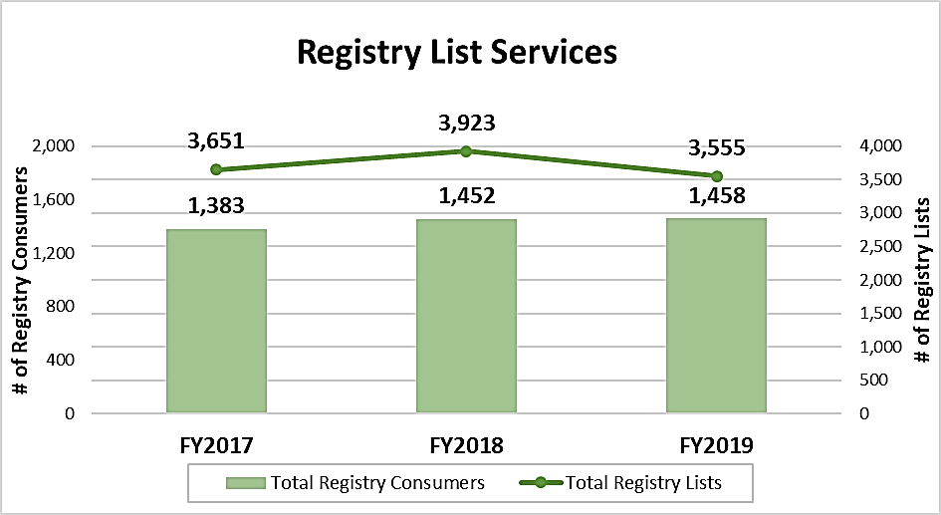
Registry (for Consumers)
FY2019 | Number of Served
In FY2019, the Registry Program provided 3,555 referrals lists to 1,458 IHSS Consumers, 44% (635) of whom hired IHSS Providers.
New Updates
New texting platform
IHSS Consumer Handbook

Slide 5
Registry (for Providers)
FY2019 | Number of Registry Providers
During FY2019, 3,641 IHSS Providers were a part of the Registry, 23% (847) of whom worked with and/or actively looked for a Consumer.
489 applicants
321 trained
252 accepted
New Updates
Provider Connect Line (PCL)
Provider Referral Incentive

Slide 6
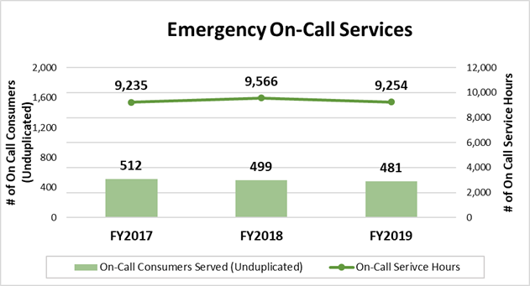
Emergency On-Call
FY2019 | Number of Served
In FY2019, 481 unduplicated Consumers received emergency care services from the On-Call workers—who serviced over 9,254 hours.
New Updates
New RFP contract (effective July 1, 2019)

Slide 7
Mentorship
FY2019 | Number of Served
In FY2019, the Mentorship Program received 413 referrals for 363 IHSS Consumers. Of all Consumers referred, 59% (215) were paired with mentors and received mentorship services, including trainings, interview assistance, and alike. Out of those who were paired with mentors, 46% (98) hired providers.
363 Referred
215 Paired
98 Hired
New Updates
Electronic Timesheets (EVV) workshops
One Stop Resource Center

Slide 8
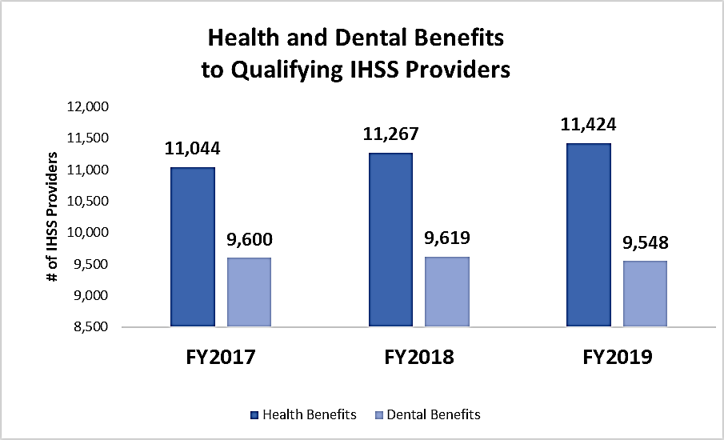
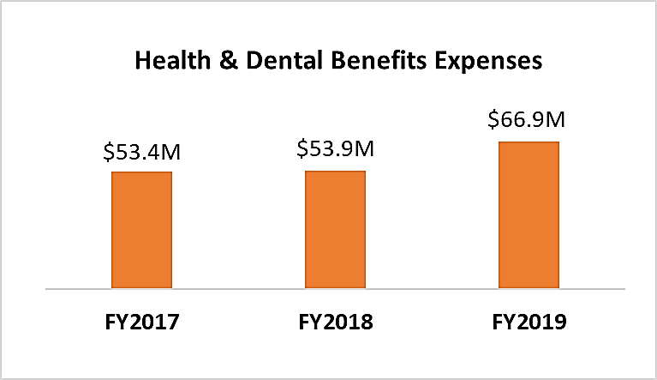
Provider Benefits
FY2019 | Number of Enrolled
In FY2019, 11,424 IHSS Providers were enrolled in San Francisco Health Plan’s Health Workers HMO; 9,548 IHSS Providers in Liberty Dental Plan’s LDP100 or EPO.
New Updates
In FY2019, the Public Authority provided health and dental insurance worth over $66.9M.

Slide 9
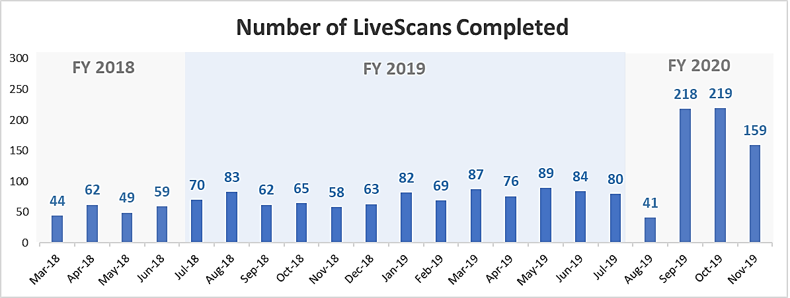
Provider Benefits
FY2019 | Number of Served
In FY2019 alone, the PA received and reviewed 4,813 criminal background results; and provided LiveScan services to 888 IHSS Providers. Since March 2018, the Public Authority has provided 1,819 LiveScan services.
New Updates
New staff member
Two locations (SF IHSS Public Authority & IPAC)

Slide 10
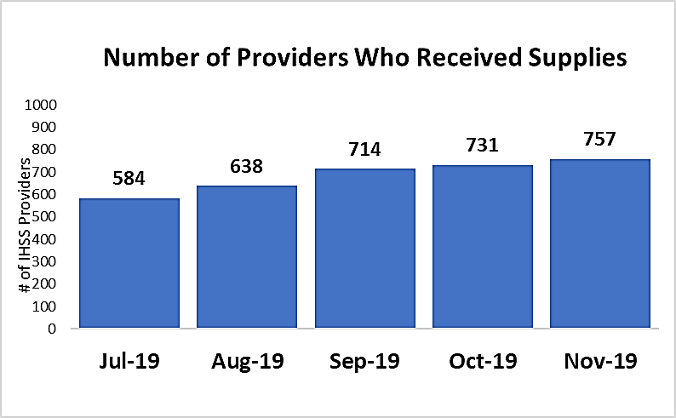
Provider Benefits
FY2019 | Number of Served
Since July 2019, the Public Authority distributed free supplies to 1,217 unduplicated IHSS Independent Providers.
New Updates
New staff member
One location (IPAC)

